Slide 1
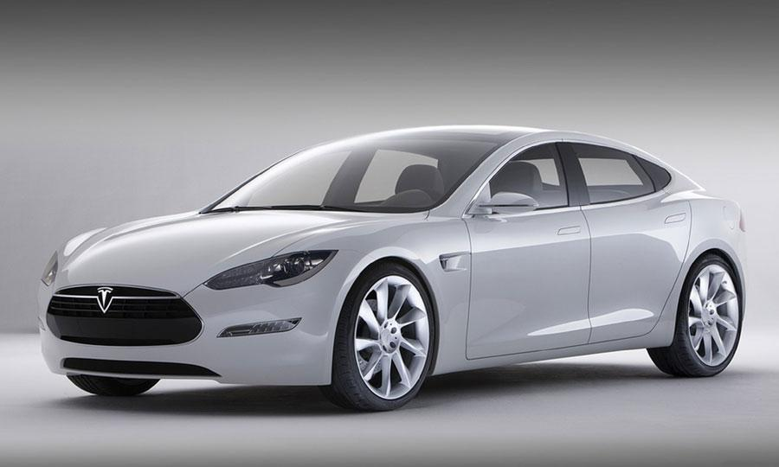
Tesla Model S
Starting price 60,000 Euros

Slide 2
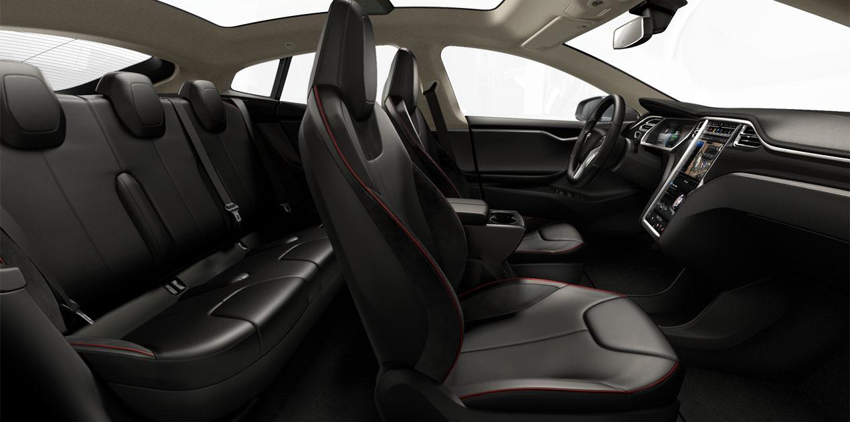

Slide 3
