Slide 1
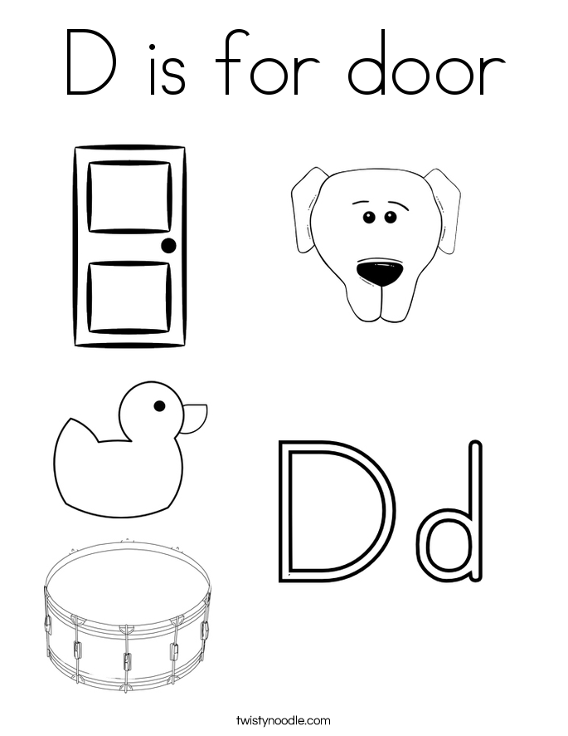
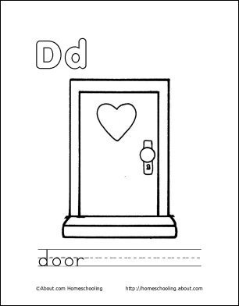
Main Idea
To show what a letter could represent
Ie, a is for apple....d is for door
The idea is to show something that the children use in their classroom everyday

Slide 2
Materials
The main part will be built out of Paper because paper can be moved around and could be used in other scenes.
A tripod for filming so that the movie is not moving
Happy music in the background because the movie is aimed at children.

